Slide 2
Enterprise Mode Deep Dive
Deen King-Smith
Program Manager | Enterprise Browsing
Fred Pullen
Senior Product Manager | Browser Marketing

Slide 3
Browser Breakout Sessions at Microsoft Ignite
CR
Topic | Session | Topic | Speaker
Enterprise Guidance | BRK2338 | Enterprise Web Browsing | Fred Pullen
How do I upgrade to Internet Explorer 11? | BRK2307 | Enterprise Mode for Internet Explorer 11 Deep Dive | Deen King-Smith
 | BRK2312 | Web App Compat & Modernization for Nerds | Chris Jackson
Tell me about Microsoft Edge | BRK1301 | Microsoft Edge Overview | Fred Pullen
 | BRK2347 | Windows 10 Browser Management | Deen King-Smith
What about security? | BRK2319 | Browser Security Overview | Fred Pullen

Slide 4
Customer Guidance
Upgrade to Internet Explorer 11 to stay supported and prepare for Windows 10
Upgrading web apps to modern web standards is still the best long-term solution
Leveraging browser backward compatibility can be a quick, effective upgrade path

Slide 5
Browser Upgrade Process
Consideration
Evaluate key benefits and upgrade drivers Review with BDMs, ITDMs, and key stakeholders to evaluate impact Map out key risks and dependencies
Planning & Evaluation
Review budget and resourcing with BDMs Evaluate hardware & infrastructure needs Conduct web app inventory, identify owners Assess 3rd party commercial ISV support agreements, software upgrades needed
Testing & Remediation
1st party & 3rd party web app testing Client testing Image & package creation Remediation for issues (backward compatibility, software upgrades, virtualized environments)
Deployment & Migration
Configure browser management Train users, if needed Prepare support teams for help desk issues that may arise Deployment (SCCM, GP, MDM)

Slide 6
Compatibility 101 or, why is web app testing & remediation so difficult?

Slide 7
Evolution of Document Modes
Internet Explorer 11
Internet Explorer 10
Internet Explorer 9
Internet Explorer 8
Internet Explorer 7
Internet Explorer 6
Internet Explorer 5

Slide 8
Evolution of Document Modes
Internet Explorer 11
Internet Explorer 10
Internet Explorer 9
Internet Explorer 8
Internet Explorer 7
Internet Explorer 6
Internet Explorer 5

Slide 9
Evolution of Document Modes
Internet Explorer 11
Internet Explorer 10
Internet Explorer 9
Internet Explorer 8
Internet Explorer 7
Compatibility View
IE7 if DOCTYPE tag
IE5 if no DOCTYPE tag
Internet Explorer 6
Internet Explorer 5

Slide 10
Evolution of Document Modes
Internet Explorer 11
Internet Explorer 10
Internet Explorer 9
Internet Explorer 8
Internet Explorer 7
Internet Explorer 6
Internet Explorer 5

Slide 11
Evolution of Document Modes
Internet Explorer 11
Internet Explorer 10
Internet Explorer 9
Internet Explorer 8
Internet Explorer 7
Internet Explorer 6
Internet Explorer 5

Slide 12
Evolution of Document Modes
Internet Explorer 11
Internet Explorer 10
Internet Explorer 9
Internet Explorer 8
Internet Explorer 7
Internet Explorer 6
Internet Explorer 5

Slide 13
Internet Explorer 11 Document Modes
Internet Explorer 11
Internet Explorer 11 (edge)
Internet Explorer 10
Internet Explorer 9
Internet Explorer 8
Internet Explorer 7 (CV)
Internet Explorer 5 (quirks)

Slide 14
Internet Explorer 11 Document Modes
Internet Explorer 11
Internet Explorer 11 (edge)
Internet Explorer 10
Internet Explorer 9
Internet Explorer 8
Internet Explorer 7 (CV)
Internet Explorer 5 (quirks)
Interoperable Quirks

Slide 15
Internet Explorer 11 Document Modes
Internet Explorer 11
Internet Explorer 11 (edge)
Internet Explorer 10
Internet Explorer 9
Internet Explorer 8
Internet Explorer 7 (CV)
Internet Explorer 5 (quirks)
Interoperable Quirks
IE8 Enterprise Mode

Slide 16
Internet Explorer 11 Document Modes
Internet Explorer 11
Internet Explorer 11 (edge)
Internet Explorer 10
Internet Explorer 9
Internet Explorer 8
Internet Explorer 7 (CV)
Internet Explorer 5 (quirks)
Interoperable Quirks
IE8 Enterprise Mode
IE7 Enterprise Mode

Slide 17
Internet Explorer 11 Document Modes
Internet Explorer 11
Internet Explorer 11 (edge)
Internet Explorer 10
Internet Explorer 9
Internet Explorer 8
Internet Explorer 7 (CV)
Internet Explorer 5 (quirks)
Interoperable Quirks
IE8 Enterprise Mode
IE7 Enterprise Mode

Slide 18
Browser Upgrade Resources or, what we doing to make it better?

Slide 19
Browser Upgrade Resources
Consideration
Study from Forrester Consulting: “The Total Economic Value of Internet Explorer 11” Microsoft IT Showcase White Papers TechNet & MSDN technical documentation
Planning & Evaluation
Use Enterprise Site Discovery to assess your web app environment Microsoft Services Microsoft Partners
Testing & Remediation
Leverage Enterprise Mode for backward compatibility Upgrade to modern standards using Modern.IE Microsoft Services Microsoft Partners
Deployment & Migration
Multiple deployment methods (SCCM, GP, MSIs, IEAK) Manage through 1600+ Group Policies Microsoft Services Microsoft Partners

Slide 20
Evaluation/Testing ⇨ Remediation
F12 Developer Tools
Tests all potential combinations
Requires some user training
Manual collection
Little configuration needed
IT
Enterprise Mode Collection
Tests IE8 Enterprise Mode only
Requires little user training
Automatic collection
Some configuration
Enterprise Mode
Ready to Upgrade
Enterprise Site Discovery
Shows how web apps are used in current environment
Requires no user training
Automatic collection
Configuration needed

Slide 21
Enterprise Site Discovery

Slide 22

Enterprise Site Discovery
Site A
Site Scoping
Data-Driven Picture of Web Environment
Local Data Collection (WMI/XML)
Site B
Site C
User Browses the Web (IE8, IE9, IE10, or IE11)
User browses the Web
Users browse the Web
Site C
IE8, IE9, IE10, IE11 support
Site scoping by Domain & Zone (Privacy Feature)
XML or WMI Output
Group Policy Management
Bulk XML import support in Site List Manager Tool

Slide 23
Enterprise Site Discovery Data
Data point | IE11 | IE10 | IE9 | IE8 | Description
IE Version | X | X | X | X
URL | X | X | X | X | URL of the browsed site, including any parameters included in the URL.
Domain | X | X | X | X | Top-level domain of the browsed site.
ActiveX GUID | X | X | X | X | The GUID of the ActiveX controls loaded by the site.
Document mode | X | X | X | X | Document mode used by Internet Explorer for a site, based on page characteristics.
Document mode reason | X | X |  |  | Additional information about why a document mode was set by Internet Explorer.
Browser state reason | X | X |  |  | Additional information about why the browser is in its current state. Also called, browser mode.
Hang count | X | X | X | X | Number of visits to the URL when the browser hung.
Crash count | X | X | X | X | Number of visits to the URL when the browser crashed.
Most recent navigation failure (and count) | X | X | X | X | Description of the most recent navigation failure (like, a 404 bad request or 500 internal server error) and the number of times it happened.
Number of visits | X | X | X | X | The number of times a site has been visited.
Zone | X | X | X | X | Zone used by Internet Explorer to browse sites, based on browser settings.

Slide 24
Enterprise Site Discovery Demo

Slide 25
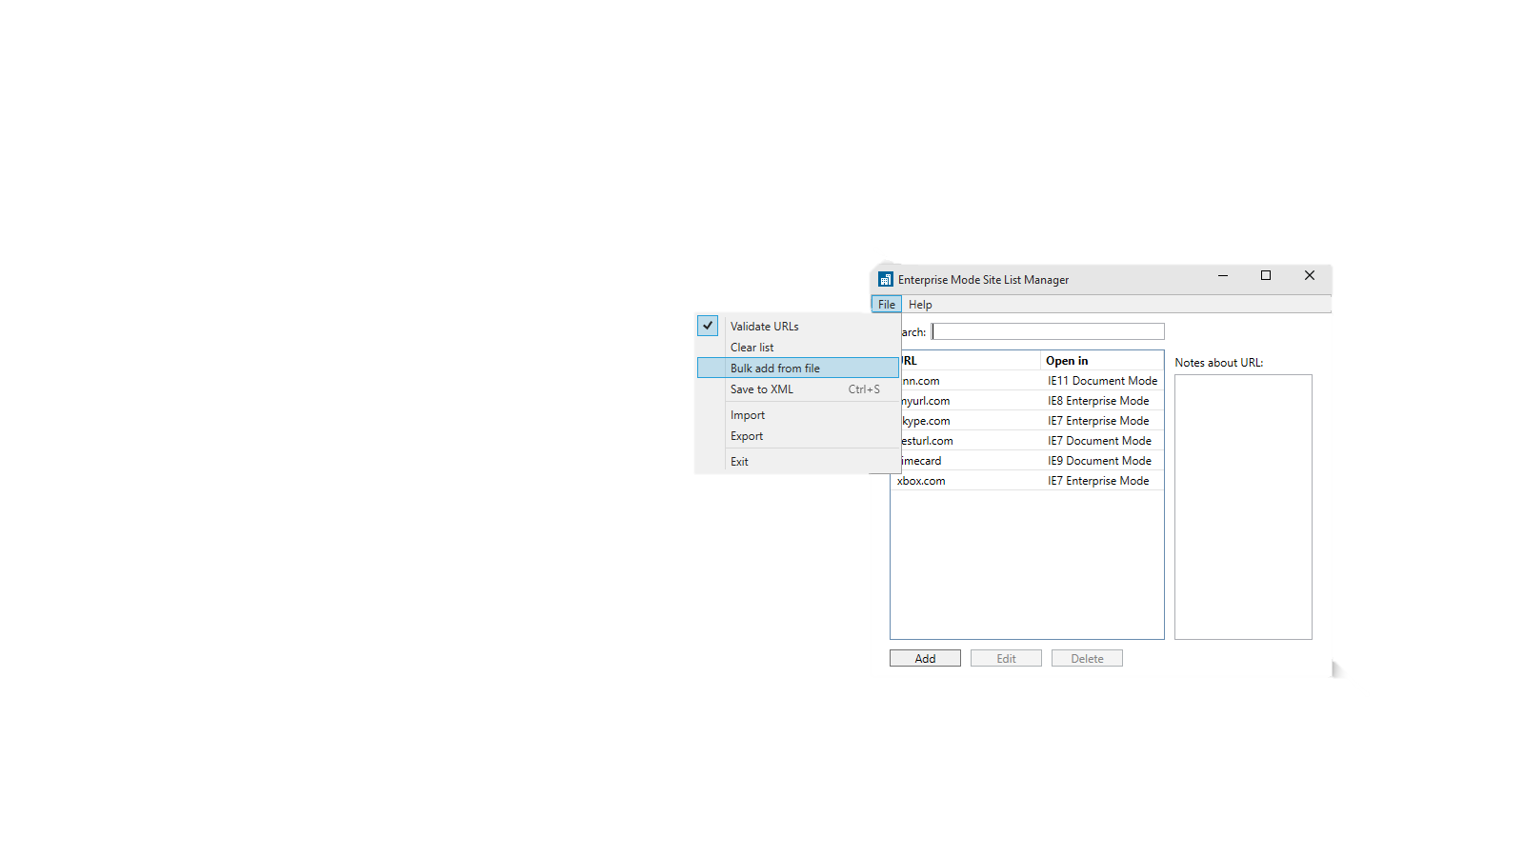
Import into the Enterprise Mode Site List
Bulk add directly connects Enterprise Site Discovery to Enterprise Mode

Slide 26
Enterprise Mode & Testing with F12 Developer Tools

Slide 27
Enterprise Mode Site List Features
Enterprise Mode Site List (XML File)
<docMode> section
IE11 Document Mode
IE10 Document Mode
IE9 Document Mode
IE8 Document Mode
IE7 Document Mode
IE5 Document Mode
<emie> section
IE8 Enterprise Mode
IE7 Enterprise Mode
<docMode>
Document Mode
User Agent String
<emie>
Document Mode
Original User Agent String
ActiveX Controls
Deprecated Functions
Caching & Pre-Rendering
Vertical Languages
High
Fidelity Emulation

Slide 28
F12 Developer Tools Testing Method
Enterprise Mode Site List (XML File)
<docMode> section
IE11 Document Mode
IE10 Document Mode
IE9 Document Mode
IE8 Document Mode
IE7 Document Mode
IE5 Document Mode
<emie> section
IE8 Enterprise Mode
IE7 Enterprise Mode
Start Here
Set both Document Mode and User Agent string to test each mode
High
Fidelity Emulation

Slide 29
F12 Developer Tools Testing Method
Enterprise Mode Site List (XML File)
<docMode> section
IE11 Document Mode
IE10 Document Mode
IE9 Document Mode
IE8 Document Mode
IE7 Document Mode
IE5 Document Mode
<emie> section
IE8 Enterprise Mode
IE7 Enterprise Mode
Start Here
Set both Document Mode and User Agent string to test each mode
Then Here
Set browser profile to Enterprise Mode for IE8 Enterprise Mode, then use IE7 and IE5 doc modes for IE7 Enterprise Mode.
High
Fidelity Emulation

Slide 30

Enterprise Mode Management
Easy-to-use Group Policies and Registry Keys
Group Policies
“Let users turn on and use Enterprise Mode from the Tools menu”
“Use the Enterprise Mode IE website list”
Registry Keys
HKLM\SOFTWARE\Policies\Microsoft\Internet Explorer\Main\EnterpriseMode
Enable the Tools menu: “Enable” = “” or “{URL}{:port}”
Enable the XML site list: “SiteList” = “{File Path or URL}”
✓

Slide 31
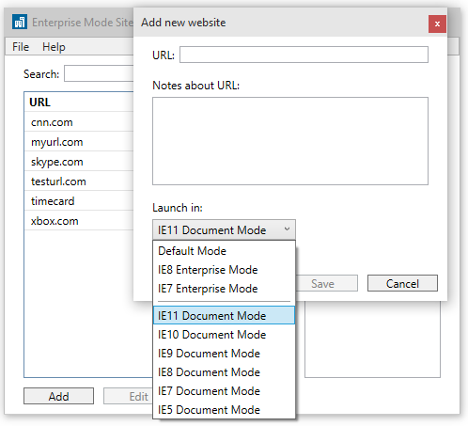
Enterprise Mode Site List
True/false “exclude” syntax enables fine-grained control
<rules version="3">
<emie>
<domain exclude="false">crm
<path exclude="true">/NewModule</path>
</domain>
</emie>
<docMode>
<domain docMode=“9”>webtool</domain>
</docMode>
</rules>

Slide 32
Enterprise Mode Demo

Slide 33
Enterprise Mode Drives Results
90%
Customer Quotes
47%
“Enterprise Mode makes
the upgrade possible.”
“We no longer need to
test for multiple browsers.”
“We have literally saved millions of
dollars in support costs around the world.”
47% of IT Pros surveyed said the upgrade to Internet Explorer 11 was easier than expected—and 90% of these used backward compatibility features to ease their migration
Source: “The Total Economic Impact of Internet Explorer 11,” a commissioned study conducted by Forrester Consulting on behalf of Microsoft, March 2015

Slide 34
Prescriptive Testing Guidance

Slide 35
If you’re upgrading from Internet Explorer 8 . . .
Use the Enterprise Mode Site List to add sites to IE5, IE7, and IE8 modes. You can test with the F12 developer tools to determine the right mode, or use Enterprise Site Discovery to see what mode is being used now.
Sites with x-ua-compatible meta tag or HTTP header set to “IE=edge” may break in IE11 and need to be set to IE8 mode. This is because Edge in IE8 meant IE8 mode, but Edge in IE11 means IE11 mode.
Sites without a DOCTYPE in zones other than Intranet will default to QME (or “interoperable quirks”) rather than IE5 Quirks and may need to be set to IE5 mode.
Some IE5, IE7, and IE8 sites may need to be added to Enterprise Mode to work.
Some sites may need to be added to both Enterprise Mode and Compatibility View to work. You can do this by using the IE7 Enterprise Mode setting.

Slide 36
If you’re upgrading from Internet Explorer 9 . . .
Use the Enterprise Mode Site List to add sites to IE5, IE7, and IE9 modes. You can test with the F12 developer tools to determine the right mode, or use Enterprise Site Discovery to see what mode is being used now.
Sites with x-ua-compatible meta tag or HTTP header set to “IE=edge” may break in IE11 and need to be set to IE9 mode. This is because Edge in IE9 meant IE9 mode, but Edge in IE11 means IE11 mode.
Sites without a DOCTYPE in zones other than Intranet will default to QME rather than IE5 Quirks and may need to be set to IE5 mode.
If your sites worked in IE9, you won’t need Enterprise Mode but can still take advantage of the <docMode> section of the Enterprise Mode Site List.

Slide 37
If you’re upgrading from Internet Explorer 10 . . .
Use Enterprise Mode Site List to add sites to IE5, IE7, and IE10 modes. You can test with the F12 developer tools to determine the right mode, or use Enterprise Site Discovery to see what mode is being used now.
Sites with x-ua-compatible meta tag or HTTP header set to “IE=edge” may break in IE11 and need to be set to IE10 mode. This is because Edge in IE10 meant IE10 mode, but Edge in IE11 means IE11 mode.
If your sites worked in IE10, you won’t need Enterprise Mode but can still take advantage of the newer <docMode> section of the Enterprise Mode Site List.

Slide 38
Summary and Resources

Slide 39
Browser Upgrade Summary
Consideration
Forrester Consulting study “The Total Economic Value of Internet Explorer 11” MSIT App & Browser Compatibility Case Studies TechNet & MSDN technical documentation
Planning & Evaluation
Use Enterprise Site Discovery to assess your web app environment Microsoft Services Premier Support Consulting Services Microsoft Partners
Testing & Remediation
Leverage Enterprise Mode for backward compatibility Upgrade to modern standards using Modern.IE Microsoft Services Microsoft Partners
Deployment & Migration
Multiple deployment methods (SCCM, GP, MSIs, IEAK) Manage through 1600+ Group Policies

Slide 40
Next Steps
All of the tools and resources
in this session are available today
Upgrade to Internet Explorer 11
for support after January 12, 2016
and to ease migrations to Windows 10

Slide 41
Internet Explorer 11 Upgrade Resources
CR
TechNet for IT Pros: technet.microsoft.com/ie
MSDN for Developers: msdn.microsoft.com/ie
Upgrading Apps to Modern Standards: modern.ie

Slide 42
Browser Session Schedule at Microsoft Ignite
CR
Day | Time | Location | Topic | Speaker
Monday | 1:30pm | E253 | Microsoft Edge Overview | Fred Pullen
 | 6:00pm | Hall A1/A2 | Ask the Experts | Enterprise Browsing Team
Tuesday | 9:00am | S401 | Enterprise Web Browsing | Fred Pullen
Wednesday | 9:00am | E451b | Windows 10 Browser Management | Deen King-Smith
 | 3:15pm | E451b | Browser Security Overview | Fred Pullen
Thursday | 9:00am | N427 | Enterprise Mode for Internet Explorer 11 Deep Dive | Deen King-Smith
 | 3:15pm | S502 | Web App Compat & Modernization for Nerds | Chris Jackson
 | 11am-5pm | N135 | Drop-In App Compat Troubleshooting Workshop | Enterprise Browsing Team

Slide 43
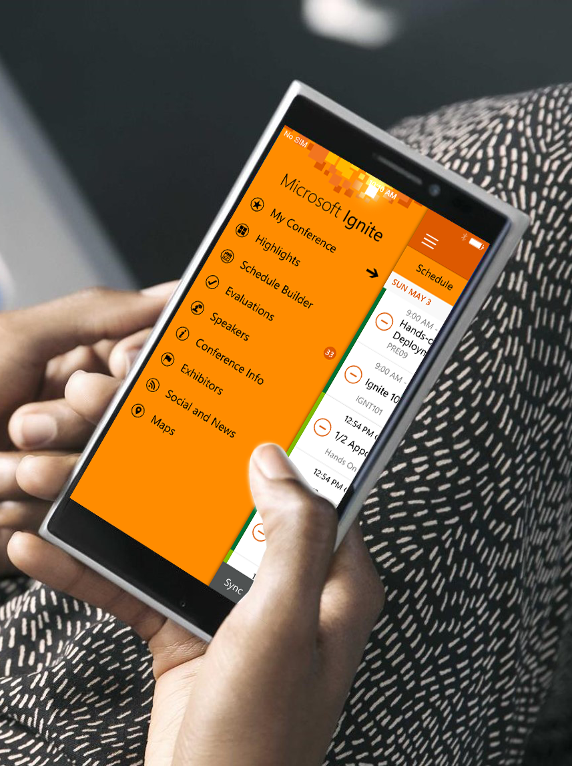
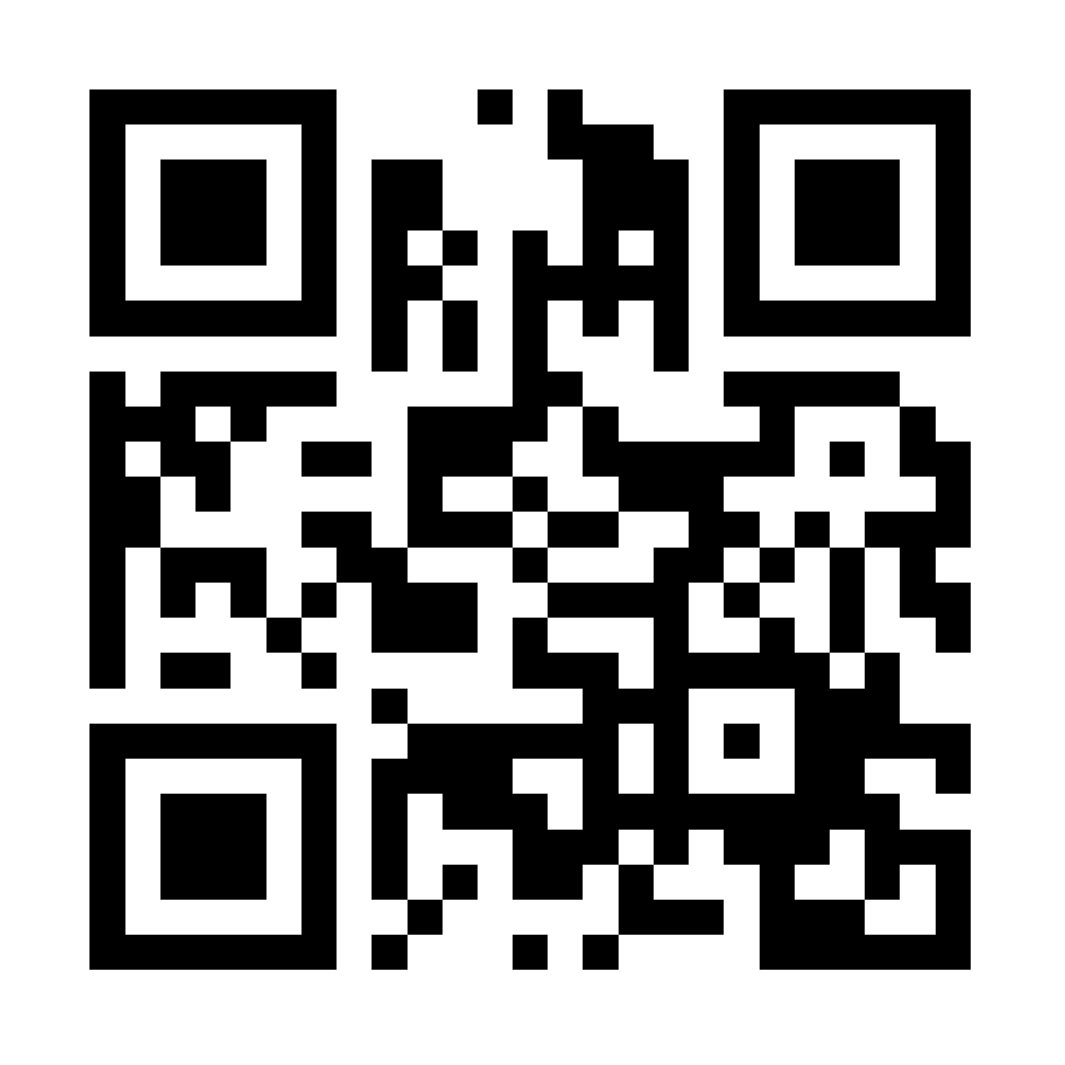
Please evaluate this session
Your feedback is important to us!
Visit Myignite at http://myignite.microsoft.com or download and use the Ignite Mobile App with the QR code above.

